Slide 1



Splash Screen

Slide 2
Lesson Menu
Five-Minute Check (over Lesson 5–2)
Then/Now
New Vocabulary
Example 1: Write an Inequality
Concept Summary: Inequalities
Example 2: Real-World Example: Write an Inequality
Example 3: Determine Truth of an Inequality
Example 4: Graph an Inequality
Example 5: Write an Inequality

Slide 3

5-Minute Check 1
Solve 2x + 15 = 7x. Check your solution.
A. 1
B. 2
C. 3
D. 4

Slide 4

5-Minute Check 2
Solve 5a = 3a – 18. Check your solution.
A. –11
B. –10
C. –9
D. –8

Slide 5

5-Minute Check 3
Solve 1.3 – 3b = b – 0.3. Check your solution.
A. 0.8
B. 0.4
C. –0.4
D. –0.8

Slide 6

5-Minute Check 4
Solve 4x – 7 = –5x – 25. Check your solution.
A. –32
B. –2
C. 2
D. 32

Slide 7

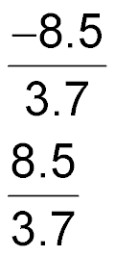
5-Minute Check 5
Solve 7.5 + n = 2.7n – 1. Check your solution.
A. –5
B.
C.
D. 5

Slide 8

5-Minute Check 6
An art studio charges $8 a day plus a membership fee of $15. Another studio charges $5 a day plus a membership fee of $24. After how many days of studio use will the cost of both studios be the same?
A. 6
B. 5
C. 4
D. 3

Slide 9


Then/Now
You have already solved equations and graphed the solution on a number line. (Lessons 4–3 and 4–4)
Write inequalities.
Graph inequalities on a number line.

Slide 10

Vocabulary
inequality

Slide 11
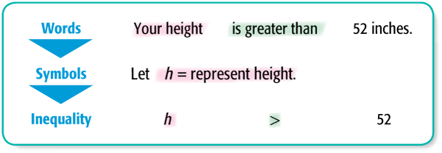
Example 1 A
Write an Inequality
A. Write an inequality for the following sentence. Your height is greater than 52 inches.
Answer: h > 52

Slide 12
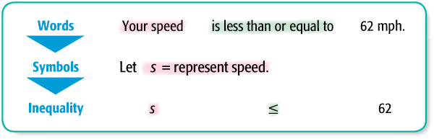
Example 1 B
Write an Inequality
B. Write an inequality for the following sentence. Your speed is less than or equal to 62 mph.
Answer: s ≤ 62

Slide 13


Example 1 CYP A
A. Write an inequality for the following sentence. Your height is less than 48 inches.
A. h < 48
B. h > 48
C. h ≤ 48
D. h ≥ 48

Slide 14
Example 1 CYP B
B. Write an inequality for the following sentence. Your age is greater than 12 years.
A. a < 12
B. a > 12
C. a ≤ 12
D. a ≥ 12

Slide 15
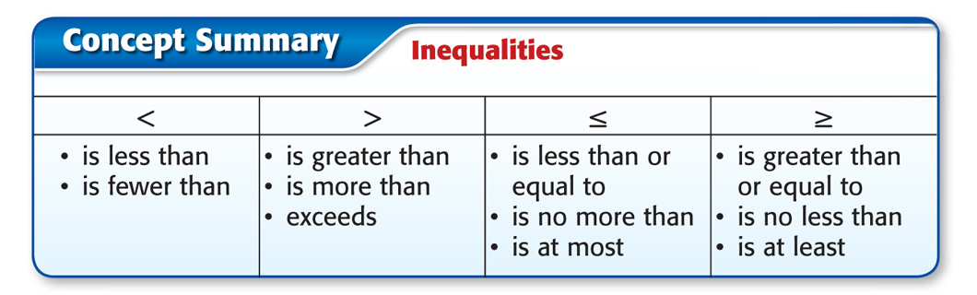
Concept

Slide 16
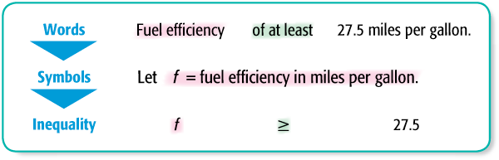
Example 2
Write an Inequality
ENVIRONMENT To meet a certain air quality standard, an automobile must have a fuel efficiency of at least 27.5 miles per gallon. Write an inequality to describe this situation.
Answer: The inequality is f ≥ 27.5.

Slide 17
Example 2 CYP
CAFETERIA The school cafeteria allows each student no more than 2 servings of dessert during lunch. Write an inequality to describe this situation.
A. s < 2
B. s > 2
C. s ≤ 2
D. s ≥ 2

Slide 18

Example 3 A
Determine the Truth of an Inequality
A. For the given value, state whether the inequality is true or false.
s – 9 < 4, s = 6
s – 9 < 4 Write the inequality.
?
6 – 9 < 4 Replace s with 6.
–3 < 4 Simplify.
Answer: The sentence is true.

Slide 19
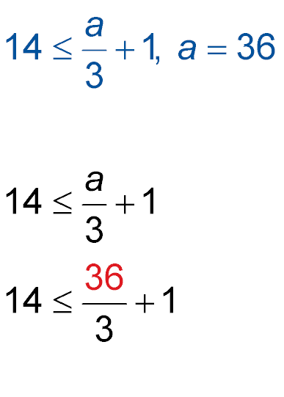
Example 3 B
Determine the Truth of an Inequality
B. For the given value, state whether the inequality is true or false.
Write the inequality.
?
Replace a with 36.
?
14 ≤ 12 + 1 Simplify.
14 ≤ 13 Simplify.
Answer: The sentence is false.

Slide 20
Example 3 CYP A
A. For the given value, state whether the inequality is true or false.
12 – m > 7, m = 5
A. true
B. false
C. sometimes true
D. cannot be determined

Slide 21
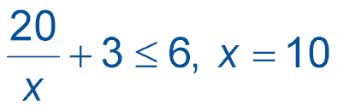
Example 3 CYP B
B. For the given value, state whether the inequality is true or false.
A. true
B. false
C. sometimes true
D. cannot be determined

Slide 22
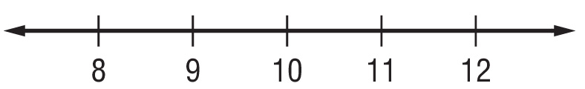
Example 4 A
Graph an Inequality
A. Graph x > 10 on a number line.
Locate 10 on a number line. Draw an open dot on 10 because 10 is not included.
Draw an arrow to the right.
The inequality x > 10 means that all numbers greater than 10 will make the sentence true.

Slide 23
Example 4 B
Graph an Inequality
B. Graph x ≤ 10 on a number line.
Locate 10 on a number line. Draw a closed dot on 10 because 10 is included.
Draw an arrow to the left.
The inequality x ≤ 10 means that all numbers less than or equal to 10 will make the sentence true.

Slide 24




Example 4 CYPA
A. Graph x < 3 on a number line.
A.
B.
C.
D.

Slide 25
Example 4 CYPB
B. Graph x > 3 on a number line.
A.
B.
C.
D.

Slide 26

Example 5
Write an Inequality
Write an inequality for the graph.
A closed circle is on –38, so the point –38 is included in the graph. The arrow points to the right, so the graph includes all numbers greater than or equal to –38.
Answer: The inequality is x ≥ –38.

Slide 27

Example 5
Write an inequality for the graph.
A. x < –7
B. x > –7
C. x ≤ –7
D. x ≥ –7

Slide 28
End of the Lesson

